Slide 1

Course code : CSE3009 Course title : No SQL Data Bases Module : 6 Topic : 6
Link Analysis Algorithms

Slide 2
Objectives
This session will give the knowledge about
Link analysis algorithms
Web as a Graph
Topic specific page rank

Slide 3
Introduction to Link analysis
Link Analysis deals with mining useful information from linked structures like graphs.
Graphs have vertices representing objects and links among those vertices representing relationships among those objects.
The most common interpretation of the word link today is hyperlink - a means of connecting two web documents wherein activating a special element embedded in one document takes you to the other.

Slide 4
Introduction to Link analysis
A link represents a relationship and connects two objects that are related to each other in that specific way.
A collection of links representing the same kind of relationship form a network, or graph, where the objects being related correspond to the graph vertices and the links themselves are the edges.
When two objects being related by a link are of the same kind, then the network formed by such links is termed a homogeneous network.

Slide 5
Introduction to Link analysis
The friendship relation, for instance, forms a homogeneous network of friends, whereas the car-owner relation defines a heterogeneous network.
When a network consists of several kinds of links, it is said to be multi-relational, or sometimes multi-mode.
An example could be a family tree that connects people using relationships, such as parent-child, sibling, spouse, etc.
Link analysis can also give us some interesting insight into the world around us. In the World Wide Web, if web pages are considered as nodes and hyperlinks as edges, then the link analysis will help us to understand which page is appropriate.

Slide 6
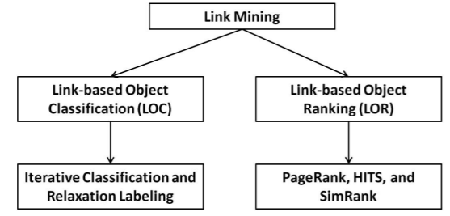
Kinds of Link Analysis Tasks

Slide 7
Link-based Object Classification (LOC)
LOC (Link-based Object Classification) is a technique used to assign class labels to nodes according to their link characteristics. One very simplified example is to classify nodes as strongly connected and weakly connected depending solely on their degree.
LOC can also incorporate information about a node’s properties for classification.
For instance, if your task is to create compatible teams from a pool of personnel, and you have generic preference data from everyone, then you can build up a graph, where each node represents a person and each edge represents a common preference between two persons
A slightly more complex process would be to find the average distance of each node to all the other nodes, and classify them according to that quantity.

Slide 8
Link-based Object Ranking (LOR)
LOR (Link-based Object Ranking) ranks objects in a graph based on several factors affecting their importance in the graph structure, whereas LOC assigns labels specifically belonging to a closed set of finite values to an object.
The purpose of LOR is not to assign distinctive labels to the nodes—usually, all nodes in such networks are understood to be of the same type—the goal is to associate a relative quantitative assessment with each node.
LOR can sometimes be a more fine-grained version of LOC, such as in our strongly/weakly connected example, if we desire to mark each node with the precise number representing its degree of connectivity, then it can be one form of ranking the nodes.

Slide 9
Link-based Object Ranking (LOR)
Ranking tasks are usually much more complex than that, and take into account a large part of the graph when coming up with a figure for each node.
One of the most well-known ranking tasks is ranking web pages according to their relevance to a search query.

Slide 10
Link prediction
While LOC and LOR use analysis of links to talk about the nodes in a network, Link Prediction actually deals with links themselves.
A common example of prediction is trying to guess which authors will co-author a paper in the future, given a current collaboration graph.
Here, we try to infer new collaboration links, but do not say anything new about the authors themselves.

Slide 11
Link prediction
Some Link prediction Algorithms:
Adamic Adar (algo.linkprediction.adamicAdar)
Common Neighbors (algo.linkprediction.commonNeighbors)
Preferential Attachment (algo.linkprediction.preferentialAttachment)
Resource Allocation (algo.linkprediction.resourceAllocation)
Same Community (algo.linkprediction.sameCommunity)
Total Neighbors (algo.linkprediction.totalNeighbors)

Slide 12

Common Neighbours
Common neighbors captures the idea that two strangers who have a friend in common are more likely to be introduced than those who don’t have any friends in common.
It is computed using the following formula:
common neighbors
where N(x) is the set of nodes adjacent to node x, and N(y) is the set of nodes adjacent to node y. A value of 0 indicates that two nodes are not close, while higher values indicate nodes are closer.
The library contains a function to calculate closeness between two nodes.

Slide 13
Common Neighbours algorithm sample
MERGE (zhen:Person {name: "Zhen"})
MERGE (praveena:Person {name: "Praveena"})
MERGE (michael:Person {name: "Michael"})
MERGE (arya:Person {name: "Arya"})
MERGE (karin:Person {name: "Karin"})

Slide 14
Common Neighbors algorithm sample
MERGE (zhen)-[:FRIENDS]-(arya)
MERGE (zhen)-[:FRIENDS]-(praveena)
MERGE (praveena)-[:WORKS_WITH]-(karin)
MERGE (praveena)-[:FRIENDS]-(michael)
MERGE (michael)-[:WORKS_WITH]-(karin)
MERGE (arya)-[:FRIENDS]-(karin)

Slide 15
Common Neighbors algorithm sample
MATCH (p1:Person {name: 'Michael'})
MATCH (p2:Person {name: 'Karin'})
RETURN algo.linkprediction.commonNeighbors(p1, p2) AS score

Slide 16
Web as a Graph
Web as a directed graph:
Nodes: Webpages
Edges: Hyperlinks
I teach a class on Networks.
CS224W: Classes are in the Gates building
Computer Science Department at Stanford
Stanford University

Slide 17
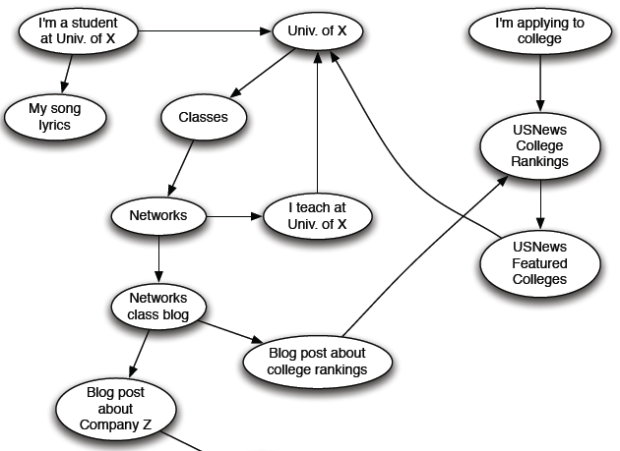
Web as a Directed Graph

Slide 18
Web as a Directed Graph
How to organize the Web?
First try: Human curated Web directories
Yahoo, DMOZ, LookSmart
Second try: Web Search
Information Retrieval investigates: Find relevant docs in a small and trusted set
Newspaper articles, Patents, etc.
But: Web is huge, full of untrusted documents, random things, web spam, etc.

Slide 19
Web Search: Challenges
2 challenges of web search:
(1) Web contains many sources of information Who to “trust”?
Trick: Trustworthy pages may point to each other!
(2) What is the “best” answer to query “newspaper”?
No single right answer
Trick: Pages that actually know about newspapers might all be pointing to many newspapers

Slide 20
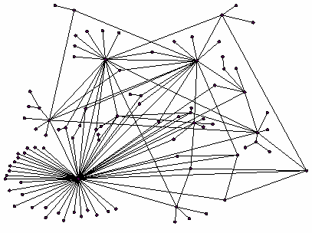
Ranking Nodes on the Graph
All web pages are not equally “important”
www.viteee.vit.ac.in vs. www.vit.ac.in
There is large diversity in the web-graph node connectivity. Let’s rank the pages by the link structure!

Slide 21
Link Analysis Algorithms
We will cover the following Link Analysis approaches for computing importance of nodes in a graph:
Page Rank
Topic-Specific (Personalized) Page Rank
Web Spam Detection Algorithms

Slide 22
Some Problems with PageRank
Measures generic popularity of a page
Will ignore/miss topic-specific authorities
Solution: Topic-Specific PageRank (next)
Uses a single measure of importance
Other models of importance
Solution: Hubs-and-Authorities
Susceptible to Link spam
Artificial link topographies created in order to boost page rank
Solution: TrustRank

Slide 23
Topic-Specific PageRank
Instead of generic popularity, can we measure popularity within a topic?
Goal: Evaluate Web pages not just according to their popularity, but by how close they are to a particular topic, e.g. “sports” or “history”
Allows search queries to be answered based on interests of the user
Example: Query “Trojan” wants different pages depending on whether you are interested in sports, history and computer security

Slide 24
Topic-Specific PageRank
Random walker has a small probability of teleporting at any step
Teleport can go to:
Standard PageRank: Any page with equal probability
To avoid dead-end and spider-trap problems
Topic Specific PageRank: A topic-specific set of “relevant” pages
Idea: Bias the random walk
When walker teleports, she pick a page from a set S
S contains only pages that are relevant to the topic
E.g., Open Directory (DMOZ) pages for a given topic/query
For each teleport set S, we get a different vector r_{S}

Slide 25
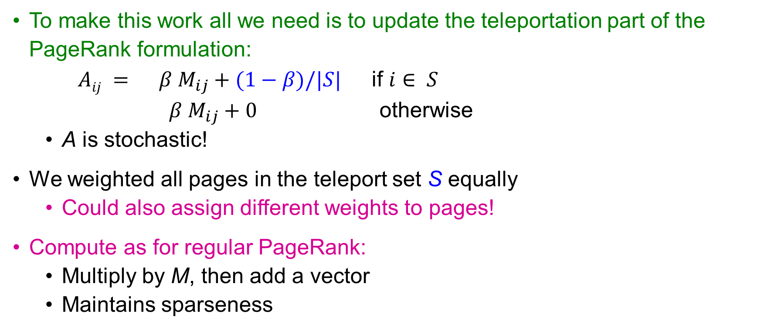
Matrix Formulation
To make this work all we need is to update the teleportation part of the PageRank formulation:
$Aij = β M_{ij}+(1−β)/|S|$ if $i∈ S$
$β M_{ij}+0$ otherwise
A is stochastic!
We weighted all pages in the teleport set S equally
Could also assign different weights to pages!
Compute as for regular PageRank:
Multiply by M, then add a vector
Maintains sparseness

Slide 26
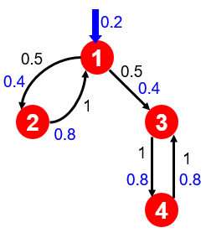
Example: Topic-Specific PageRank
Suppose S = {1}, β = 0.8
S={1,2,3,4}, β=0.8:
r=[0.13, 0.10, 0.39, 0.36]
S={1,2,3} , β=0.8:
r=[0.17, 0.13, 0.38, 0.30]
S={1,2} , β=0.8:
r=[0.26, 0.20, 0.29, 0.23]
S={1} , β=0.8:
r=[0.29, 0.11, 0.32, 0.26]
Node Iteration
0 1 2 … stable
1 0.25 0.4 0.28 0.294
2 0.25 0.1 0.16 0.118
3 0.25 0.3 0.32 0.327
4 0.25 0.2 0.24 0.261
S={1}, β=0.90:
r=[0.17, 0.07, 0.40, 0.36]
S={1} , β=0.8:
r=[0.29, 0.11, 0.32, 0.26]
S={1}, β=0.70:
r=[0.39, 0.14, 0.27, 0.19]

Slide 27
Discovering the Topic Vector S
Create different PageRanks for different topics
The 16 DMOZ top-level categories:
arts, business, sports,…
Which topic ranking to use?
User can pick from a menu
Classify query into a topic
Can use the context of the query
E.g., query is launched from a web page talking about a known topic
History of queries e.g., “basketball” followed by “Jordan”
User context, e.g., user’s bookmarks, …

Slide 28
Summary
This session will give the knowledge about
Link analysis algorithms
Web as a Graph
Topic specific page rank

